Slide 1


Statistical Modelling with Data
May 23 – June 02, 2023
Instructor: Qing (Leah) Li, Ph.D. Candidate at Cumming School of Medicine
qing.li2@uclagary.ca
Thank you Dr. Thuntida Ngamkham for contributing the contents
Thank you Dr. Qingrun Zhang and Dr. Quan Long for contributing some slides

Slide 2
Statistical Modelling with Data
Topic 1: Statistical Modelling
Lecture 1: First-order models with quantitative independent variables
Topic 2: Statistical Modelling with interactions (Assignment 1)
Lecture 2: Interaction effects, quantitative and qualitative variables
Lecture 3: Interaction effects and second-order models
Topic 3: Statistical Model selection (Assignment 2)
Lecture 4: Model selection: Stepwise regression, Forward selection and Backward Elimination
Lecture 5: Model selection: Evaluate the reliability of the model chosen
Topic 4: Statistical model diagnostics
Lecture 6: Multiple regression diagnostics: verify linearity, independence, equal variance assumptions and normality assumptions.
Lecture 7: Multiple regression diagnostics: identify multicollinearity and outliers and data transformation.
Topic 5: Transfer learning
Lecture 8: Deep learning basics
Lecture 9: Transfer-learning (Bonus): standing on the shoulders of giants.

Slide 3
Statistical Modelling with Data
Topic 1: Statistical Modelling
Lecture 1: First-order models with quantitative independent variables
Topic 2: Statistical Modelling with interactions (Assignment 1)
Lecture 2: Interaction effects, quantitative and qualitative variables
Lecture 3: Interaction effects and second-order models
Topic 3: Statistical Model selection (Assignment 2)
Lecture 4: Model selection: Stepwise regression, Forward selection and Backward Elimination
Lecture 5: Model selection: Evaluate the reliability of the model chosen
Topic 4: Statistical model diagnostics
Lecture 6: Multiple regression diagnostics: verify linearity, independence, equal variance assumptions, and normality assumptions.
Lecture 7: Multiple regression diagnostics: identify multicollinearity and outliers and data transformation.
Topic 5: Transfer learning
Lecture 8: Deep learning basics
Lecture 9: Deep learning advances: Transfer-learning (Bonus).

Slide 4
Statistical Modelling with Data
Learning Outcomes: At the end of the course, participants will be able to
Model the multiple linear relationships between a response variable (Y) and all explanatory variables (both categorical and numerical variables) with interaction terms. Interpret model parameter estimates, construct confidence intervals for regression coefficients, evaluate model fits, and visualize correlations between a response variable (Y) and all explanatory variables (X) by graphs (scatter plot, residual plot) to assess model validity.
Predict the response variable at a certain level of the explanatory variables once the fit model exists.
Implement R-software and analyze statistical results for biomedical and other data.
Evaluations
Assignments will be posted on Slack (our communication tool with students).
Students must attend 70% (6/9) of the sessions in order to receive the certificate and are encouraged to work on the assignments progressively throughout the course as the relevant material is covered.

Slide 5

Statistical Modelling with Data
Supportive materials
Lectures slides (2023)
R code scripts (2023)
PDF (dated 2022)
Two Assignments (dated 2022)
Slack channels
Recoding videos
Exercises
Course-documents

Slide 6
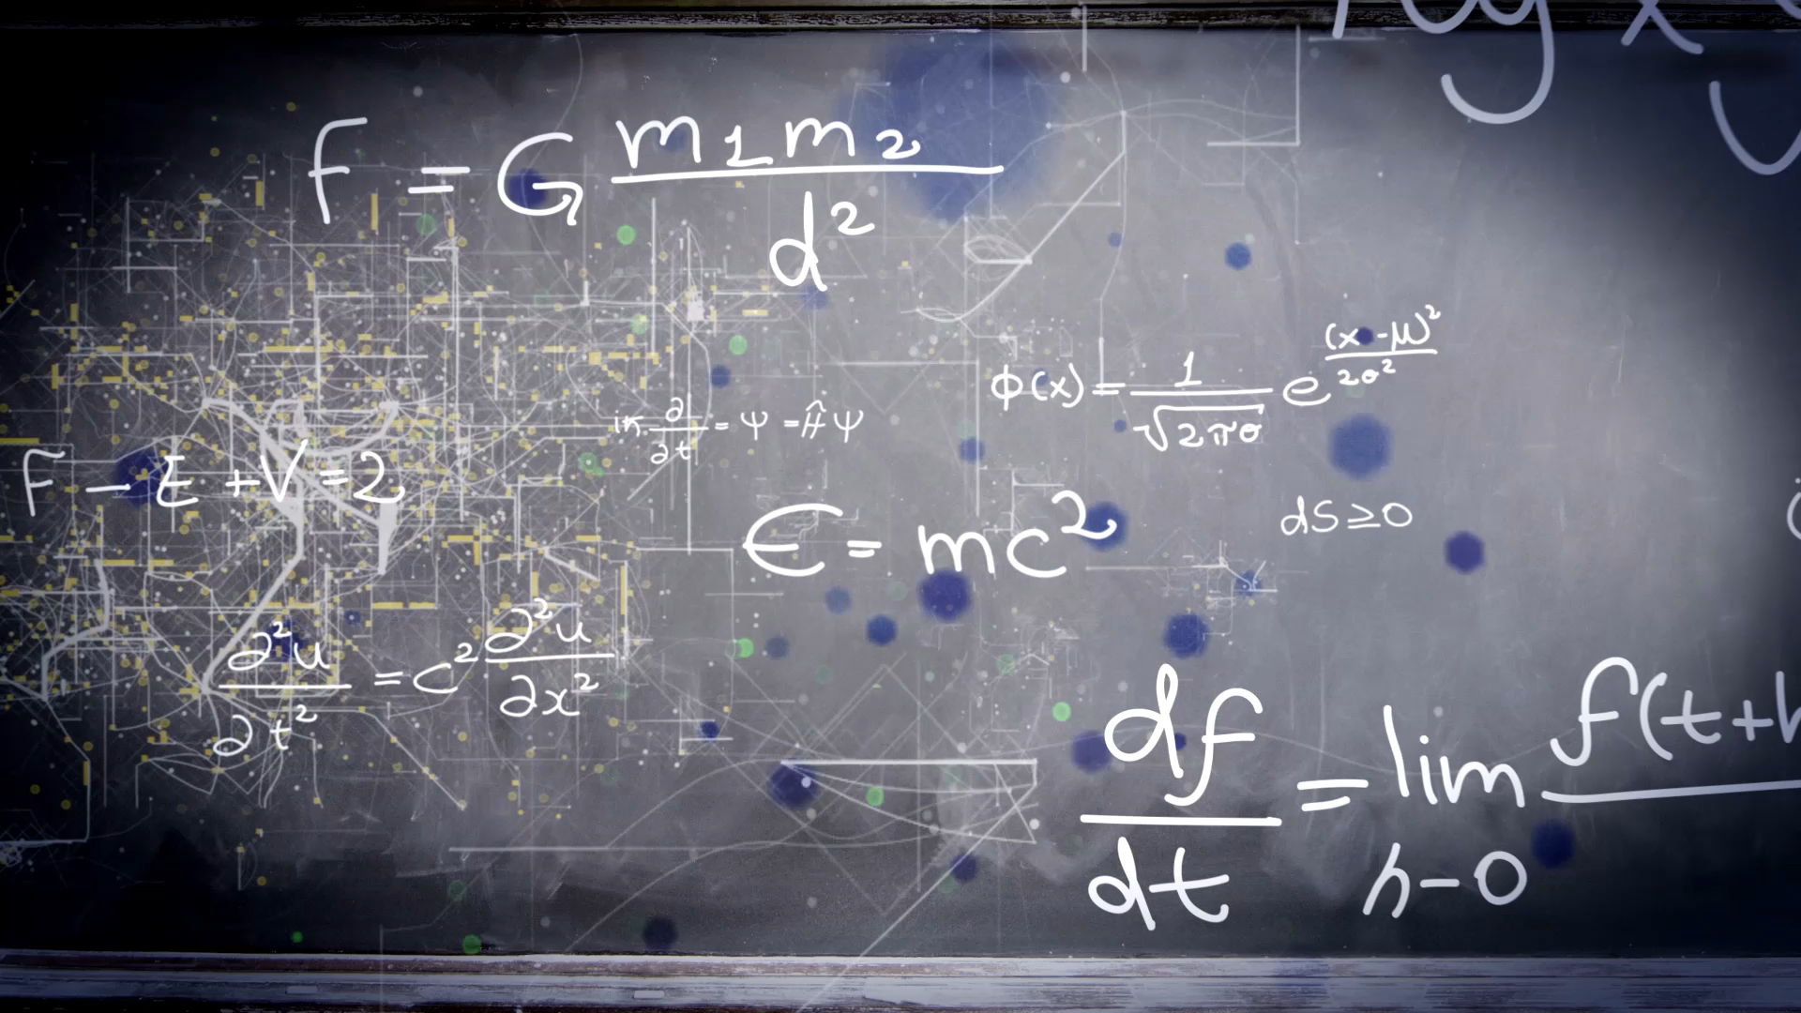
Lecture 8: Deep learning basics

Slide 7
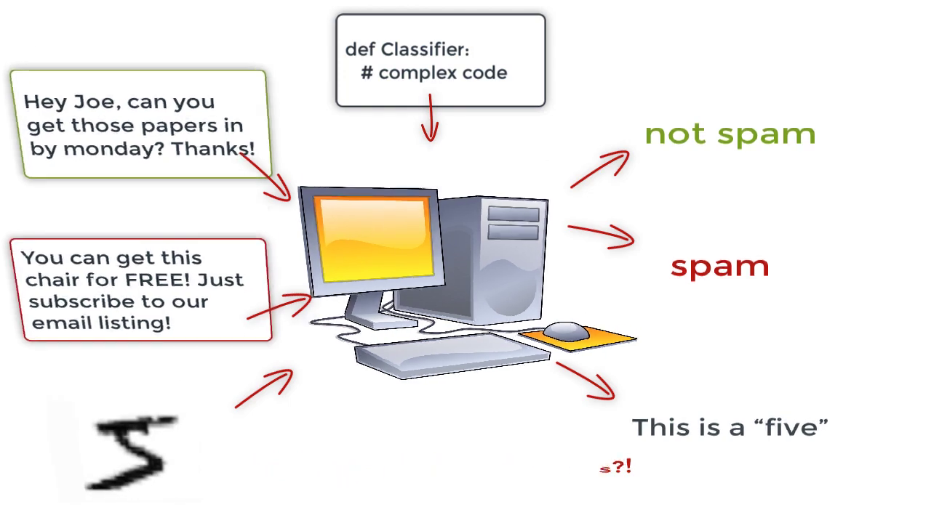
An example of machine learning: classification
Task1
Task2
Notes:
Sweep the ground and remove dust. But also clean stains on the ground.

Slide 8
Outlines
What is deep learning and why?
Build a deep learning model:
Neural network
Activation function
Loss function
TensorFlow
Datasets
Split data into training and test dataset
Model training and evaluation
Training
Evaluation Metrics
Notes:
We'll start with the basics and gradually build our knowledge from there.
We'll be covering the fundamental concepts and introducing you to the key principles of the deep learning field. By the end of today’s lecture, my goal is for each of you to have a clear understanding what deep learning models are, how model are trained and have the confidence to build some simple deep learning models yourselves.
I understand that deep learning may seem complex and overwhelming at first, but I assure you that we'll take it one step at a time. Our focus today is on simplicity and clarity. We'll break down the concepts into easily digestible pieces and provide practical examples that illustrate how deep learning models are built and trained.

Slide 9
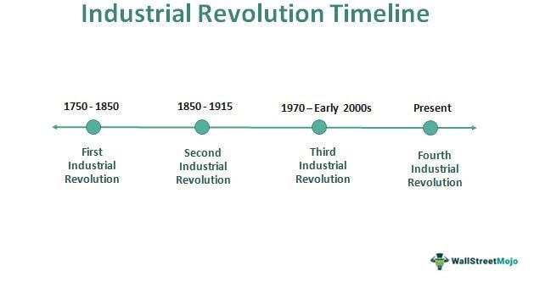
Human intelligence
https://www.wallstreetmojo.com/industrial-revolution/
Notes:
First Industrial Revolution: The First Industrial Revolution was characterized by a significant shift from manual labor and agrarian economies to mechanized industries powered by steam engines and water power.
The Second Industrial Revolution was characterized by advancements in manufacturing processes, technology, transportation, widespread use of electricity.
The third Industrial Revolution, It builds upon the foundation laid by the First and Second Industrial Revolutions and emphasizes the integration of physical and digital systems. Key elements of this revolution include the Internet, mobile phones, TVs, etc.
The fourth Industrial Revolution characterized by artificial intelligence (AI), such as smart phone, robot, etc.

Slide 10
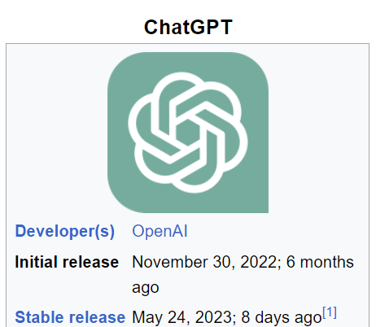
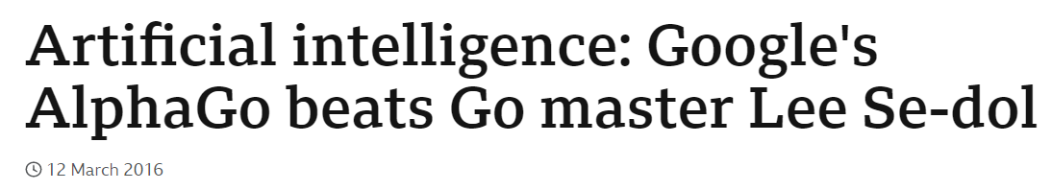
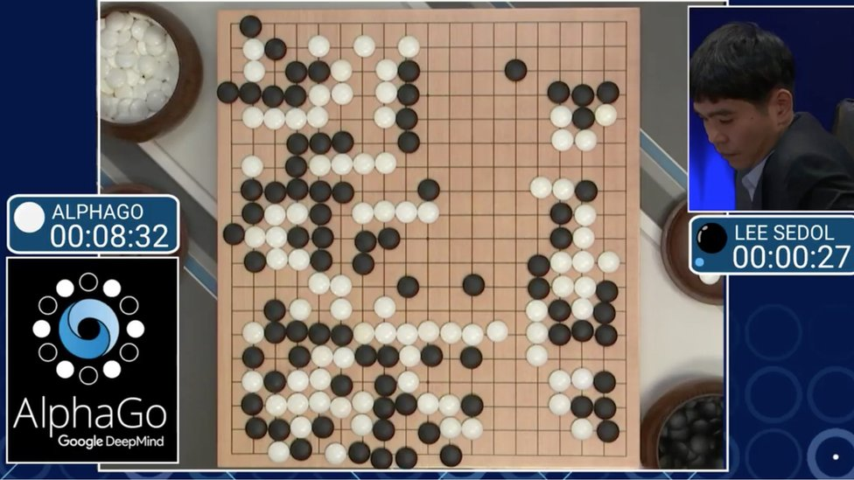
Artificial intelligence
ChatGPT is an artificial intelligence (AI) chatbot developed by OpenAI and released in November 2022. The name "ChatGPT" combines "Chat", referring to its chatbot functionality, and "GPT", which stands for Generative Pre-trained Transformer, a type of large language model (LLM) (Wiki).
https://openai.com/blog/chatgpt

Slide 11
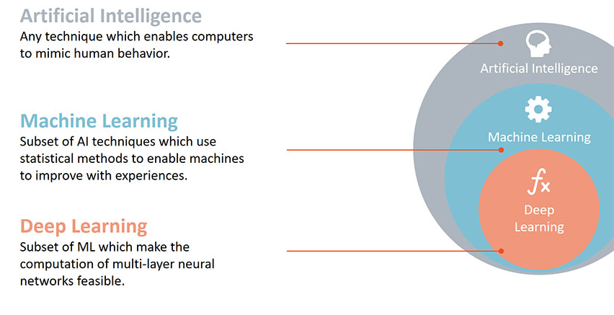


1. What is deep learning and why?
Q: Human brain is full of intelligence. Can we build machines that mimic human brain’s activities so that they can have artificial intelligence?
Statistical modelling
AI is the broader concept of developing intelligent systems, while statistical modeling, machine learning, and deep learning are specific approaches within AI. Statistical modeling focuses on analyzing data using statistical techniques, machine learning algorithms enable computers to learn from data and make predictions, and deep learning involves training deep neural networks to learn complex patterns and representations from data.
Notes:
Artificial Intelligence (AI), statistical modeling, machine learning, and deep learning are all related but distinct fields within the broader domain of data science. Here's an overview of the differences between these terms
Artificial Intelligence (AI): AI refers to the development of computer systems or machines that can perform tasks that typically require human intelligence. It involves the creation of intelligent algorithms and systems. AI encompasses a wide range of techniques, including statistical modeling, machine learning, and deep learning.
Statistical Modeling: Statistical modeling involves using statistical techniques to analyze data, identify patterns, and make predictions or inferences. It aims to understand and quantify relationships between variables in a dataset. Statistical models are based on mathematical equations and assumptions and help researchers and analysts draw conclusions about data based on statistical inference.
Machine Learning (ML): Machine learning is a subset of AI that focuses on the development of algorithms and models that enable computers to learn from data and make predictions or decisions without being explicitly programmed. ML algorithms learn patterns and relationships from training data, allowing them to make accurate predictions or take actions on unseen or new data. It encompasses various techniques such as regression, classification, clustering, and reinforcement learning.
Deep Learning: Deep learning is a specific subfield of machine learning that is inspired by the structure and function of the human brain's neural networks. It involves the construction and training of deep neural networks, which are composed of multiple layers of interconnected nodes (neurons). Deep learning excels at learning complex patterns and extracting high-level representations from raw data, such as images, text, or audio. It has achieved remarkable success in areas like computer vision, natural language processing, and speech recognition.
In summary, AI is the broader concept of developing intelligent systems, while statistical modeling, machine learning, and deep learning are specific approaches within AI. Statistical modeling focuses on analyzing data using statistical techniques, machine learning algorithms enable computers to learn from data and make predictions, and deep learning involves training deep neural networks to learn complex patterns and representations from data.

Slide 12
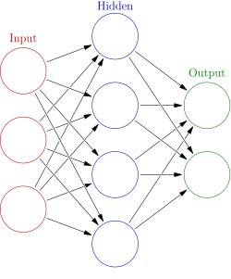
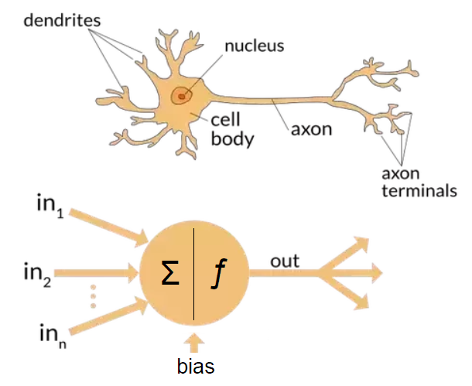
2. Build a deep learning model
Neural network (NN), are computing systems inspired by the biological neural networks that constitute animal brains (Wiki). The idea here is we want our network can perform tasks that human brain can do.
The artificial general intelligence (AGI) is a type of hypothetical intelligent agent. The AGI concept is that it can learn to accomplish any intellectual task that human beings or other animals can perform.
Human brain can perform way more complicated tasks than any machines.
https://en.wikipedia.org/wiki/Artificial_neural_network; https://en.wikipedia.org/wiki/Neuron

Slide 13
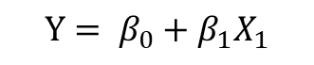
Neural network (NN)
$$Y_{1}= ω_{0}+ω_{1}X_{1}+ω_{2}X_{2}+ω_{3}X_{3}+ ε$$
$$Y_{2}= β_{0}+β_{1}X_{1}+β_{2}X_{2}+β_{3}X_{3}+ ε$$
Fully connected layer
Node: mimic one human neuron
Layer: one column of nodes. No connection between nodes in the same layer. The node in one layer is connected with nodes in the previous and next layers. If all nodes in one layer is fully connected with nodes in any layer, it’s called fully connected layer. If a network consists only fully connected layers, it called fully connected neural network.
Weights (w) and bias (b): represented by line arrows
We aim to estimate values for all weights and bias, like what we did in statistical modelling.
h1
X1
h2
Y1
X2
h3
Y2
X3
w1, b1
Y1
Y1= w1X1+b1
$${Y= β}_{0}+β_{1}X_{1}$$
h4
h1
Fully connected network
w2, b2
Y2
Y2= w2X2+b2
How many w and b in this fully connected network?

Slide 14
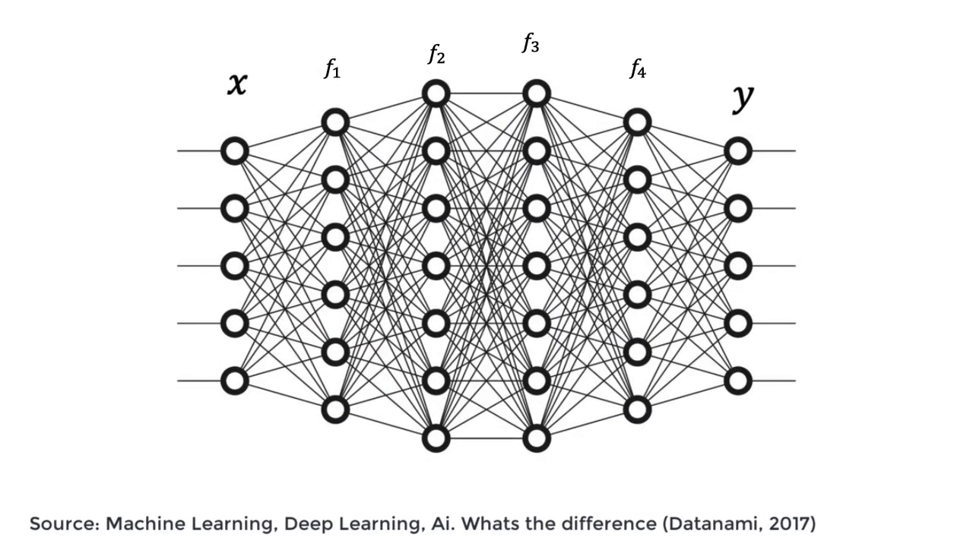
Deep Neural Network (DNN)

Slide 15
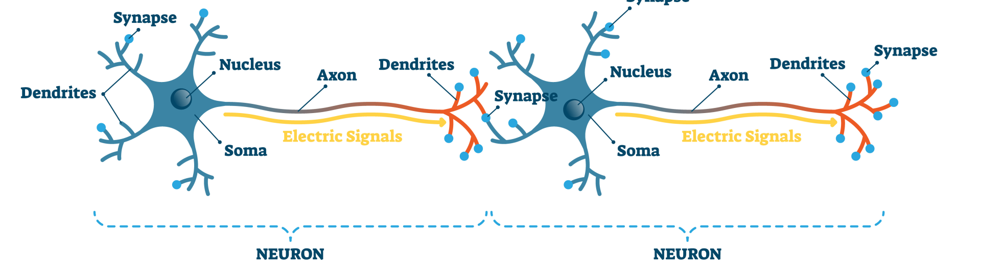
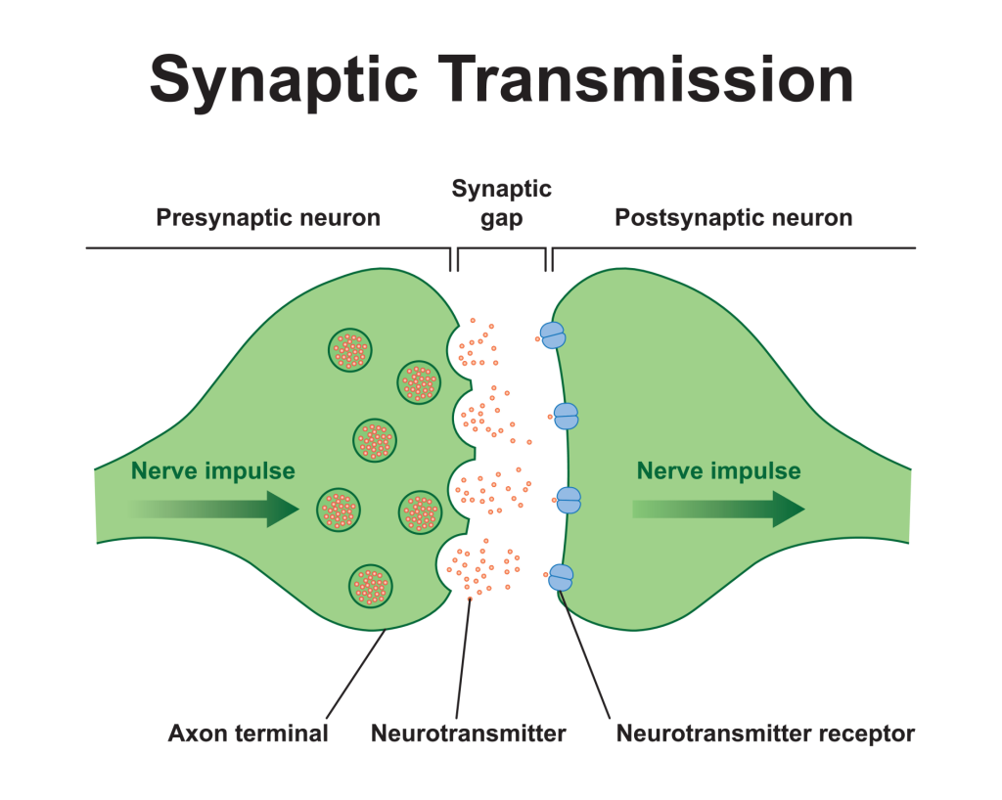
Activation function
Impulse comes
Not all impulse will be passed from the front neuron to the back one. If the front neuron passed impulse successfully, then the back one will fire (activate) and continue to transfer impulse.
We can use a function named “activation function” to describe the phenomenon whether the next neuron will be fired (active) or not.
https://www.simplypsychology.org/synapse.html
Notes:
Synapses can be either chemical or electrical and are essential to the functioning of neural activity. Neuroscientists understand that synapses play a vital role in a variety of cognitive functions, including learning and memory formation.

Slide 16
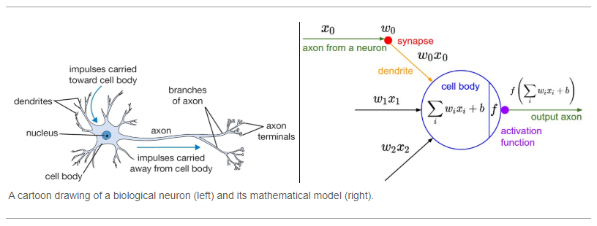
Activation function
That is exactly what an activation function does in NN as well. It takes in the output signal from the previous cell and converts it into some form that can be taken as input to the next cell.
Why activation function?
Apart from the biological similarity that was discussed earlier, they also help in keeping the value of the output from the neuron restricted to a certain limit as per our requirement.
The most important feature in an activation function is its ability to add non-linearity into a neural network.
https://www.simplypsychology.org/synapse.html
Notes:
Synapses can be either chemical or electrical and are essential to the functioning of neural activity. Neuroscientists understand that synapses play a vital role in a variety of cognitive functions, including learning and memory formation.

Slide 17
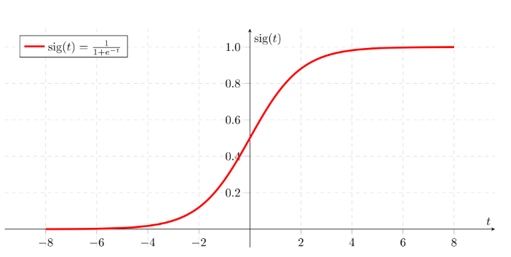
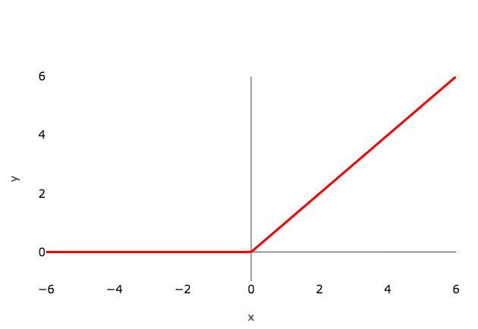
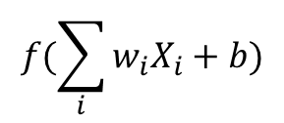
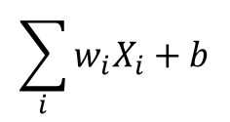
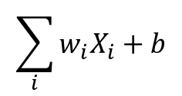
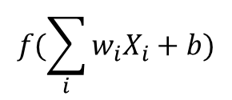
Activation functions examples
$$f(\sum_{i}{w_{i}X_{i}+b})$$
$$f(\sum_{i}{w_{i}X_{i}+b})$$
$$\sum_{i}{w_{i}X_{i}+b}$$
$$\sum_{i}{w_{i}X_{i}+b}$$

Slide 18
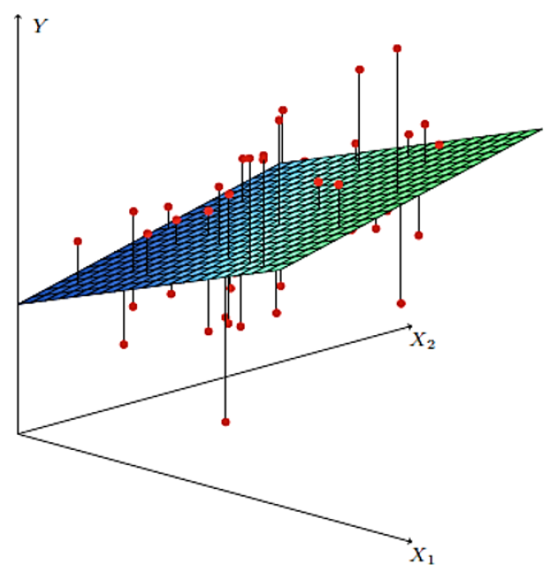
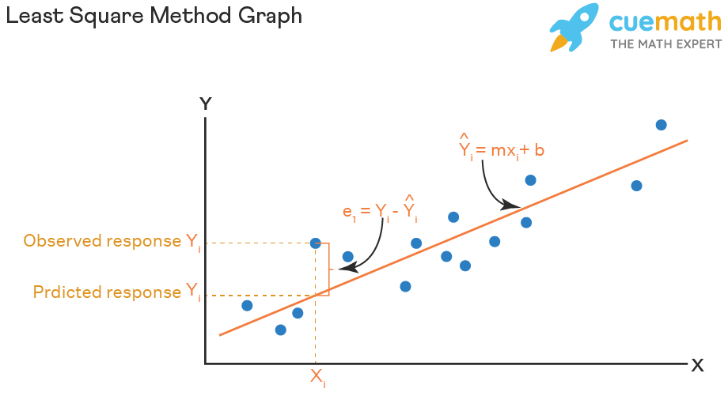
Loss function
The least squares method is a statistical procedure to find the best fit for a set of data points by minimizing the sum of the offsets or residuals of points from the plotted curve.
Parameter estimation is the process of computing a model’s parameter values from measured data.
Least square line
Loss function as it’s a function of estimated betas
Notes:
We cannot guarantee that Yi – Yi’ are always positive, so in reality, we minimize squares of Yi-Yi’

Slide 19
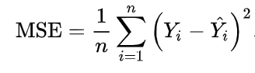
Loss function
The loss function is the function that computes the distance between the current output of the algorithm and the expected output. It’s a method to evaluate how your algorithm models the data. It can be categorized into two groups. One for classification (discrete values, 0,1,2…) and the other for regression (continuous values).
Mean square error (mse) is the average of the Sum of squared residual (SSE) over samples.
We can regard MSE as the function of betas and it is commonly used as the loss function in regression problems.
A lot of other loss function: Cross-entropy, Log loss, Exponential Loss, etc.

Slide 20
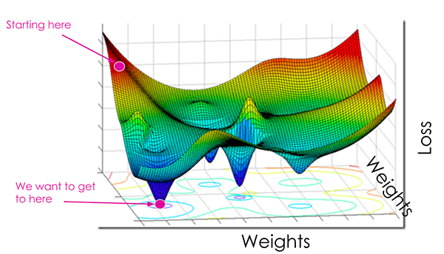

Loss function
At the most basic level, a loss function quantifies how “good” or “bad” a given predictor is at predicting the response in a dataset (regression).
The smaller the loss, the better a job the regression model or NN is at modeling the relationship between the input data and the output targets.
We, therefore, seek to:
Bring down our loss, which will improve the accuracy of our model.
Do it as quickly as possible and with as few changes or experiments to the hyperparameters as possible.
All without making our network too good at what it does by fitting the training data too well.
Player A, B, C

Slide 21
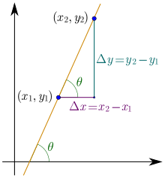

Loss function
Optimizers are algorithms or methods used to minimize an error function(loss function) or to maximize the efficiency of production.
Optimizers help to know how to change weights and learning rate of neural network to reduce the losses.
Gradient: In mathematics, the slope or gradient of a line is a number that describes both the direction and the steepness of the line (Wiki).

Slide 22

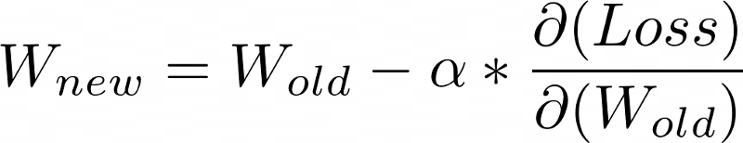
Loss function
Types of optimizer:
Gradient Descent
Stochastic Gradient Descent (SGD)
Adam(Adaptive Moment Estimation) Adam optimizer is one of the most popular and famous gradient descent optimization algorithms.
Player A
Player B
Player C
$$α:can be a constant value, also can vary. Effect by optimizers.$$

Slide 23



3. TensorFlow
TensorFlow is a free and open-source software library for machine learning and artificial intelligence. It can be used across a range of tasks but has a particular focus on training and inference of deep neural networks (Wiki).
Python packages: a package is a folder containing modules and maybe other folders that themselves may contain more folders and modules.
Python functions: A function is a block of code which only runs when it is called. You can pass data, known as parameters, into a function. A function can return data as a result.
tf.keras (https://www.tensorflow.org/guide/keras) is the simplest way to build and train neural network models in TensorFlow. So, that's what we'll stick with in this tutorial, unless the models necessitate a lower-level API.
Note that there's tf.keras comes with TensorFlow so you don't need to install anything extra, and it comes with powerful TensorFlow-specific features.
A lot of functions
tf.keras
Notes:
API is the acronym for application programming interface — a software intermediary that allows two applications to talk to each other.

Slide 24

Hands-on exercise 1: Build a fully connected neural network
Building the neural network requires configuring the layers of the model, then compiling the model.
First, we stack a few layers together using `keras.Sequential`.
Next, we configure the loss function, optimizer, and metrics to monitor. These are added during the model's compile step:
Loss function - measures how accurate the model is during training, we want to minimize this with the optimizer.
Optimizer - how the model is updated based on the data it sees and its loss function.
Metrics - used to monitor the training and testing steps.
Let's build a network with 1 hidden layer of 20 neurons, and use mean squared error (MSE) as the loss function (most common one for regression problems).

Slide 25

Coffee break
15:10

Slide 26




4. Datasets
Why split dataset into training and test?
A very common issue when training a model is overfitting. This phenomenon occurs when a model performs really well on the data that we used to train it, but it fails to generalise well to new, unseen data points. There are numerous reasons why this can happen — it could be due to the noise in data or it could be that the model learned to predict specific inputs rather than the predictive parameters that could help it make correct predictions. Typically, the higher the complexity of a model the higher the chance that it will be overfitted.
Train dataset
Test dataset
Ghojogh et al, arXiv 2019, https://en.wikipedia.org/wiki/Cross-validation_(statistics)

Slide 27
Split data into training and test dataset
Training set for training our model and then treat the testing set as a collection of data points that will help us evaluate whether the model can generalise well to new, unseen data.
A common practice is to assign 8/10 data points as training dataset and 2/10 data points as test dataset.
In case when the training accuracy is extremely high while the testing accuracy is poor then this is a good indicator that the model is probably overfitted.

Slide 28
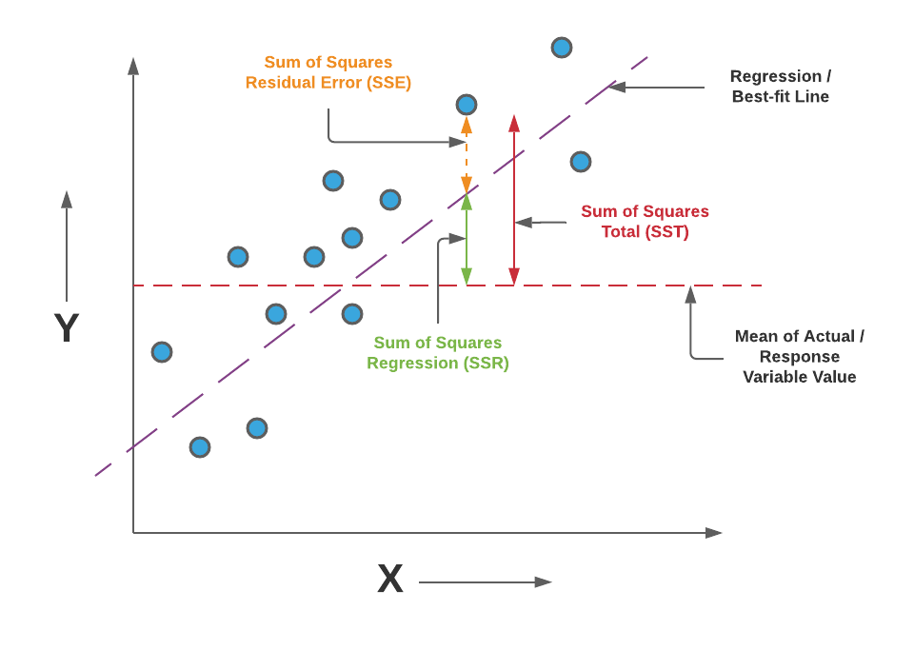

5. Model training and evaluation
A machine learning training model is a process in which a machine learning (ML) algorithm is fed with sufficient training data to learn from.
Parameter estimation is the process of computing a model's parameter values from measured data.
response, coefficients of correlation, predictors
$$g\left(y_{i}\right)= β_{0}+β_{1}X_{1}+β_{2}X_{2}+ε$$
w, b
w, b
w, b
w, b
w, b
w, b
w, b
w, b
20 bs, 20 ws

Slide 29





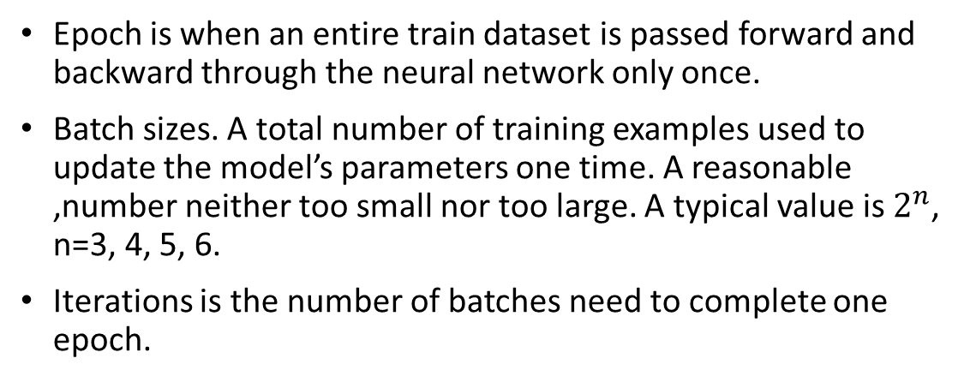
5. Model training and evaluation
Q: Are we passing all of them to NN at once?
A: It’s better to pass them in batches with a handful sample in each batch.
Epoch is when an entire train dataset is passed forward and backward through the neural network only once.
Batch sizes. A total number of training examples used to update the model’s parameters one time. A reasonable ,number neither too small nor too large. A typical value is $2^{n}$, n=3, 4, 5, 6.
Iterations is the number of batches need to complete one epoch.
Train dataset
1st time, the model sees 4 samples and update its parameters
2nd time, the model sees 4 samples and update its parameters
Epoch 1
Epoch 2
Epoch n
3rd time, the model sees 4 samples and update its parameters
…
4th time, the model sees 4 samples and update its parameters
Notes:
Why multiple epoch? updating the weights with single pass or one epoch is not enough.

Slide 30
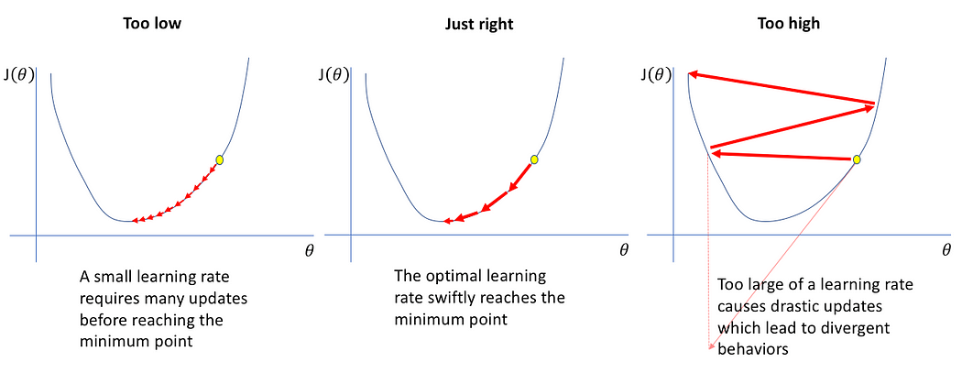
Learning rate
How big/small the steps are gradient descent takes into the direction of the local minimum are determined by the learning rate, which figures out how fast or slow we will move towards the optimal weights.

Slide 31
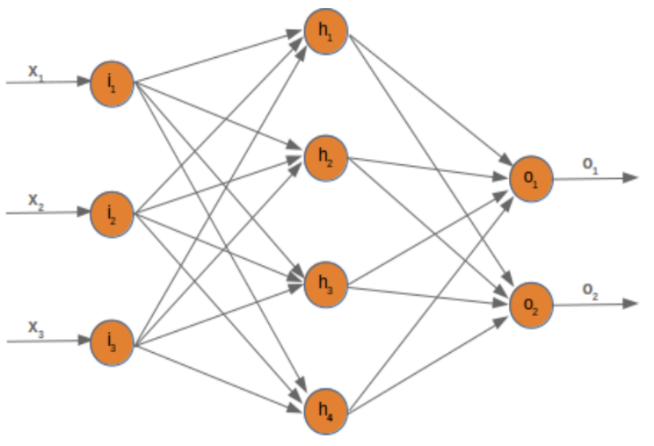
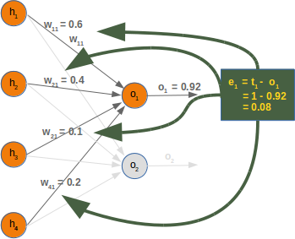
Model training
Feed forward
input training data at the input layer, and it travels from input to hidden and from hidden to the output layer
Back propagation
a widely used algorithm for training feedforward artificial neural networks
feed forward the values
calculate the error and propagate it back to the earlier layers.
https://medium.com/@jorgesleonel/backpropagation-cc81e9c772fd

Slide 32


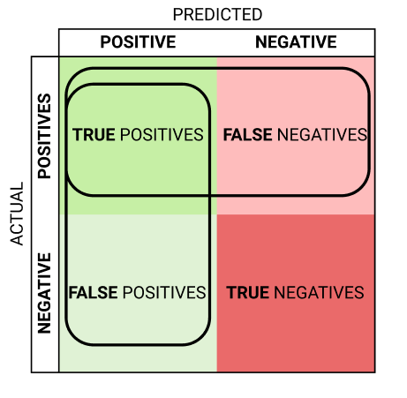
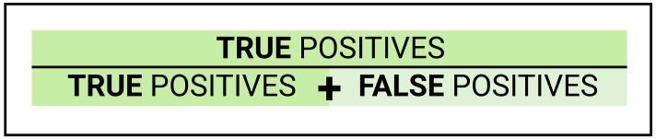


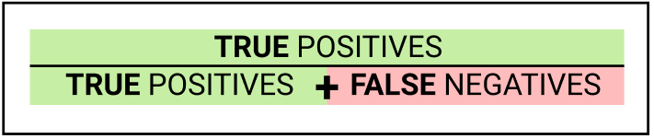
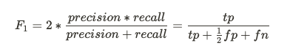
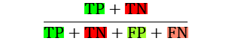
Model evaluation: Metrics
Metrics help in evaluating deep learning models on test dataset. Metrics are used to monitor and measure the performance of model. Metrics are not differentiable but in some cases is differentiable as can be used both as loss function(Regularization added) and a metric.
Regression:
Mean squared values (MSE),
Root Mean Squared Error (RMSE), the units of the RMSE are the same as the original units of the target value that is being predicted.
Mean absolute error (MAE), the units of the error score match the units of the target value that is being predicted.
Classification: a lot, precision, accuracy, F1 score, Recall, ROC cruve, etc.
Regression
Does that sound like our criteria combos 5?
Classification
Precision
Recall / TPR
F1 score
Accuracy
$$\frac{TP+TN}{TP+TN+FP+FN}$$

Slide 33
Hands-on exercise2 : Split and load datasets
Use iris_data from sklearn.datasets package and iris_load function to load iris data
Check the head of the iris_data
Split iris_data into 80% training dataset, 20% as test dataset using train_test_split() function from sklearn.model_selection package.

Slide 34
Hands-on exercise 3: Training and evaluate NN models
Use keras.datasets.boston_housing _load_data() to load predefined training and test dataset for house price.
Train the pre-build neural network with one layer and 20 nodes on the training sample.

Slide 35
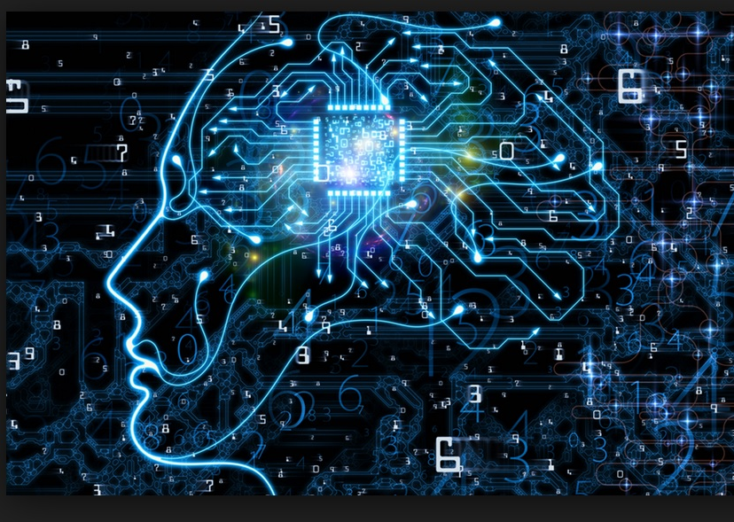
Thank you
Questions OR Comments?
Slack channel: section2-course-documents
Email: qing.li2@uclagary.ca

